Slide 1
PEOPLE OF ACTION
Subject: PI Campaign in Zone 20B
Presenter: ARPIC Nijad K. Al Atassi, D2452
Date: 19th March 2018

Slide 2
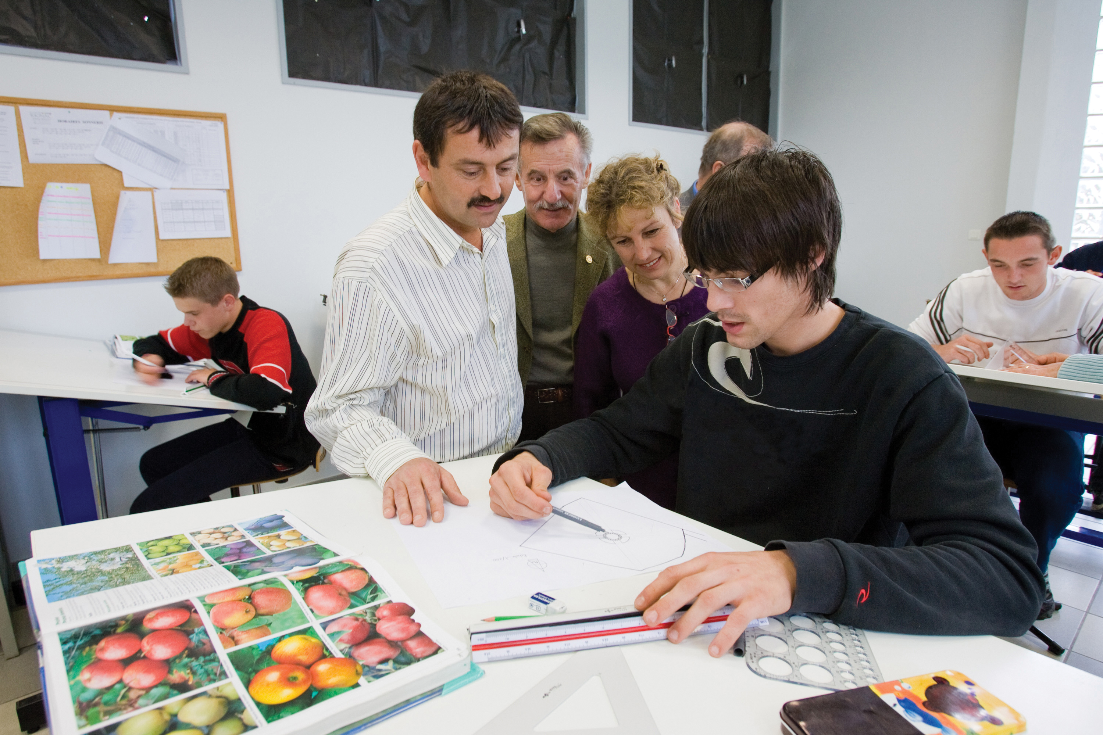
PEOPLE OF ACTION CAMPAIGN - WHAT ARE NEW AD ASSETS?
New PI advertising assets have been uploaded in the BRAND CENTER.
Using the People of Action campaign: Radio Ads
Using the People of Action campaign: Television Ads
Slide 8

Slide 3
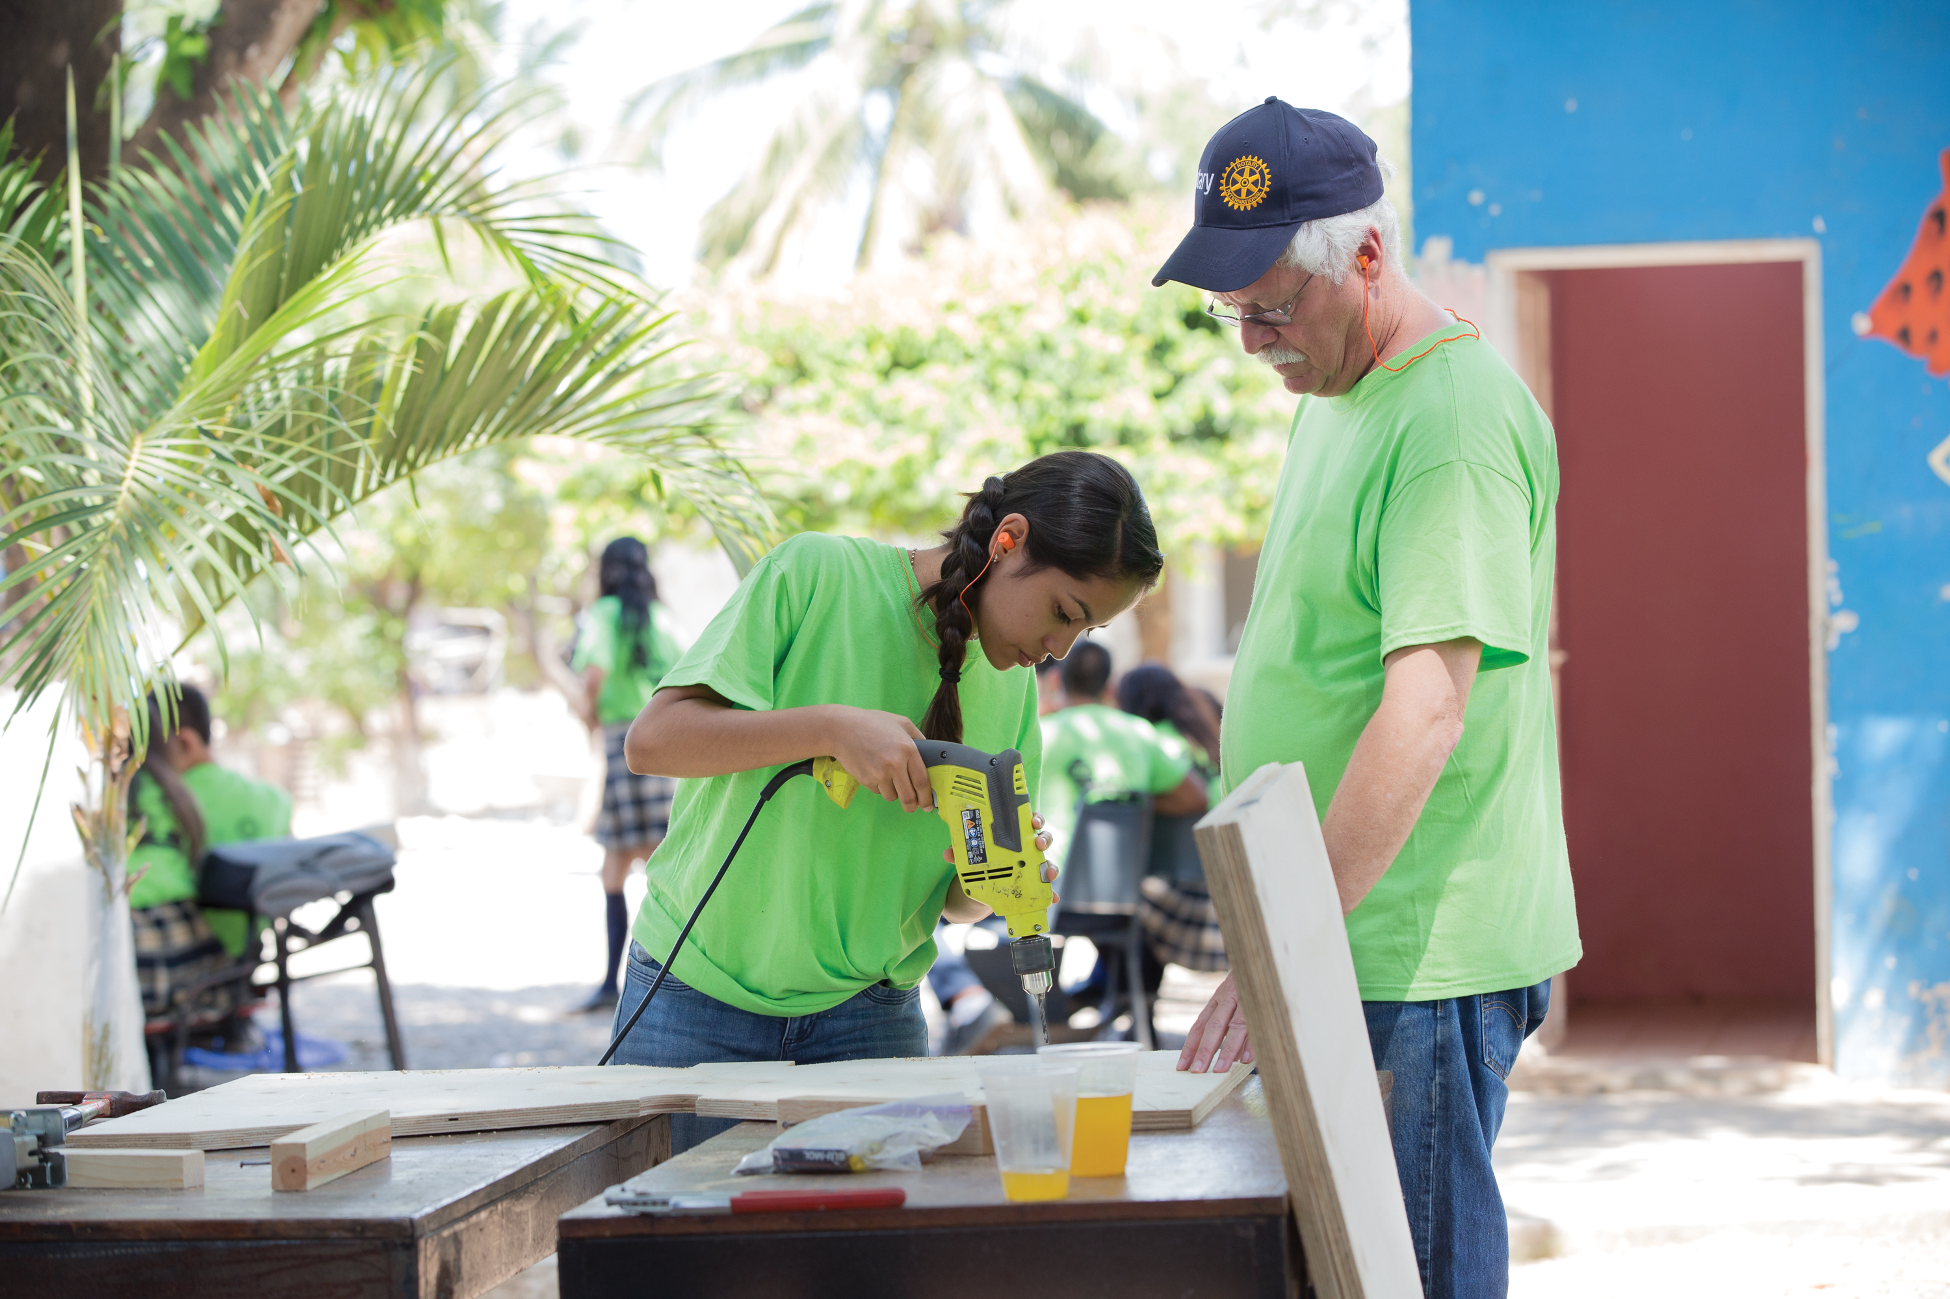
PEOPLE OF ACTION RADIO ADS & TV ADS
Awareness through Radio Ads and TV ads translates into more support for projects
Build stronger links with other community organizations
Increase interest among potential members
Effective way to increase awareness and understanding of what Rotary accomplishes in the community.
Many television stations provide public service programs, short announcements, and messages - sometimes aired at no charge for community organizations like Rotary.
Slide 8

Slide 4
PEOPLE OF ACTION RADIO ADS
Some tips on how to customize the People of Action Radio Ads to promote clubs:
Contact local station or use media connections to secure free placements of the People of Action radio ads.
Offer the pre-produced Radio Ads and scripts.
Ready to use radio ad comes in two versions:
30-second spot
20-second spot with10 seconds to add information about club at the end.
Slide 8

Slide 5
PEOPLE OF ACTION RADIO ADS
Some tips on how to customize the People of Action Radio Ads to promote clubs:
Each version can be localized with the help of the radio station or an recording facility.
The Radio Ads also has a split-audio feature, meaning the narration track is split from the other sounds. This allows a voice-over artist to rerecord the script in whatever language or dialect is appropriate.
Work with the radio station to select the right person to read the script.
Localize the ad by including club contact information.
Slide 8

Slide 6
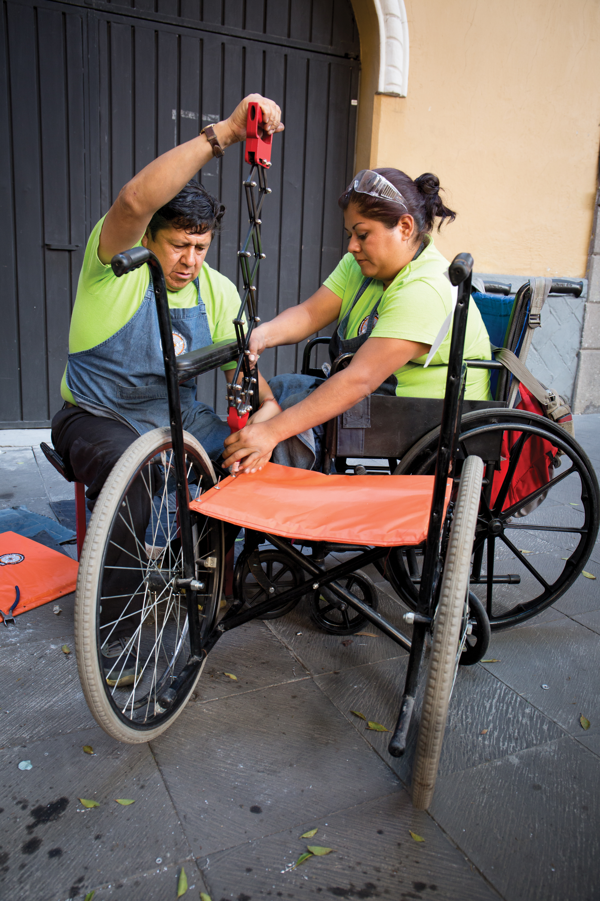
PEOPLE OF ACTION TELEVISION ADS
Some tips on how to customize the People of Action TV Ads to promote clubs:
Contact local stations and ask for the public service director or the community affairs director. Show them the video and ask them if they will air it for free.
Ready to use video is available in two versions:
30 second spots
90-second spots along with 25- and 85-second spots that leave five seconds at the end to add information about local Rotary club or district.
Slide 8

Slide 7
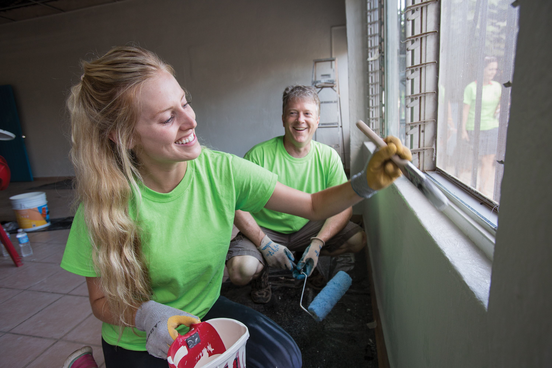
PEOPLE OF ACTION TELEVISION ADS
Some tips on how to customize the People of Action TV Ads to promote clubs:
The 25- and 85 second spots can be localized with the help of the TV station or a video editing facility.
Consider using the five extra seconds of blank space to add a message including the name of local club and club’s website
Request the television station about including Rotary’s digital ads in its online and social media platforms.
Slide 8

Slide 8
PEOPLE OF ACTION RADIO SCRIPT
People of Action Radio Script
Together, we build schools out of abandoned buildings.
Together, we bring food to hungry children in need.
Together, we see solutions instead of problems.
We are the one point two million members of Rotary, a collection of community leaders in neighborhood and around the globe brought together to do one thing: make more good happen.
Connect with us at rotary dot org (or club website)
Together, we are Rotary. And we are people of action.
Slide 8

Slide 9
WE ARE PEOPLE OF ACTION
Together we INSPIRE
Together we CONNECT
Together we
END
POLIO
Together we TRANSFORM
Slide 13

Slide 10
WE ARE PEOPLE OF ACTION
May God Bless Us All.

